Slide 1

Cyclitic Bike Share Capstone Case Study
By Farahnaz Pierre-Isme
Aspiring Junior Data Analyst

Slide 2

Introduction: About Me
Who Am I
Aspiring Junior Data Analyst with a background in healthcare operations and customer relations
Passionate about uncovering insights from complex datasets and improving business decisions
Experienced in handling patient data, customer feedback, and operational metrics
Skills & Tools
Technical: SQL, Excel, Tableau, Data Cleaning, Data Visualization
Analysis: Trend analysis, KPI reporting, dashboard creation, pivot tables
Soft Skills: Communication, problem-solving, stakeholder collaboration, leadership, attention to detail
What I Bring
Strong attention to detail and ability to translate raw data into actionable insights
Blend of analytical skills and real-world business understanding (healthcare + e-commerce)
Curiosity and commitment to continuous learning in data analytics

Slide 3
Project Overview
Scenario:
As a junior data analyst working on the marketing analyst team at Cyclitic, a bike-share company in Chicago. The director of marketing believes the company’s future success depends on maximizing the number of annual members. Your team wants to understand how casual riders and annual members use Cyclistic bikes differently. From these insights, your team will design a new marketing strategy to covert casual riders into annual members. Cyclistic executives must approve your recommendations.
Key Stakeholders:
Lily Moreno: the Director of Marketing and my manager
Cyclistic Executive Team: the notoriously detail-oriented executive team who will decide whether to approve the recommended marketing program.
Cyclistic Marketing Analytics Team: a team of data analysts who are responsible for collecting, analyzing, and reporting data that helps guide Cyclistic marketing strategy (my team)

Slide 4
Ask- Define The Business Question
Key Question: How can Design marketing team convert casual riders into annual members
How do Annual members and Casual riders use Cyclistic rides differently?
Why would casual riders buy Cyclistic annual memberships?
How can Cyclistic use digital media to influence casual riders to become members?

Slide 5
Problem Statement
Cyclistic wants to increase revenue by converting more casual riders into annual members, but it’s unclear what riding behaviors, patterns, or customer characteristics influence membership decisions
Deliverables:
A cleaned and analyzed dataset of 2019–2020 ride activity.
Data visualizations (Tableau dashboards & charts) comparing member vs. casual rider behavior.
Insights & recommendations on ride length, day of week, and seasonality trends.
A strategic proposal with targeted actions for converting casual riders into members

Slide 6

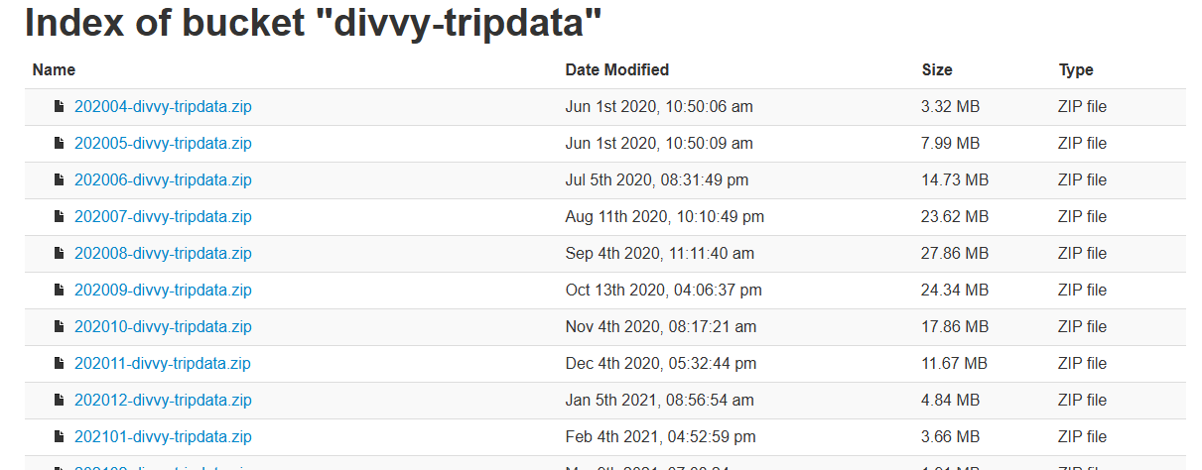
Prepare- Data Collection
Data Source:
I used the 12 month historical Divvy/Cyclistic trip data (2019–2020)
Provided by Motivate International Inc. license (CSV format)
Contains ride details: ride_id, rideable_type, start_time, end_time, start_station, end_station, member_casual
Initial Checks:
Verified data licensing & permission for use
Confirmed files are consistent (same column names across months)
Ensured dataset is large enough to answer the business question
Limitations/Considerations:
Some missing station data
Outliers (e.g., unusually long or short ride times)
No demographic or personal info included (privacy protected

Slide 7
Process- Data Cleaning & Preparations
Data Cleaning Steps :
Combined 12 monthly CSV files( 2019-2020) into one dataset
Removed duplicate ride IDs
Standardized date/time format (start & end time)
Calculated ride length (end_time – start_time)
Dropped incomplete or null station values
Data Validation
Filtered out outliers (negative or extremely long ride durations)
Ensured rideable types matched valid categories (classic_bike, docked_bike, electric_bike)
Verified member vs. casual labels were consistent
Tools Used
Excel (initial review & checks)
SQL (combining & cleaning datasets)
Tableau (later for visualization)
GitHub (create raspatory and link to visuals created)
Deliverable
A cleaned, structured dataset ready for Analyze Phase

Slide 8
Analysis- Insights
Compared member vs. casual rider usage (ride length, frequency, seasonality)
Identified peak ride times (time of day & day of week trends)
Analyzed station usage patterns (popular start/end points)
Key Findings
Casual riders generally take longer rides than members
Members ride more consistently year-round
Casual riders are more active on weekends, while members ride more on weekdays
Electric bikes popular among casual riders; classic bikes more common with members
Tools Used
SQL (queries for averages, grouping, filtering)
Excel (pivot tables for summary stats)
Tableau (visual dashboards & charts)

Slide 9
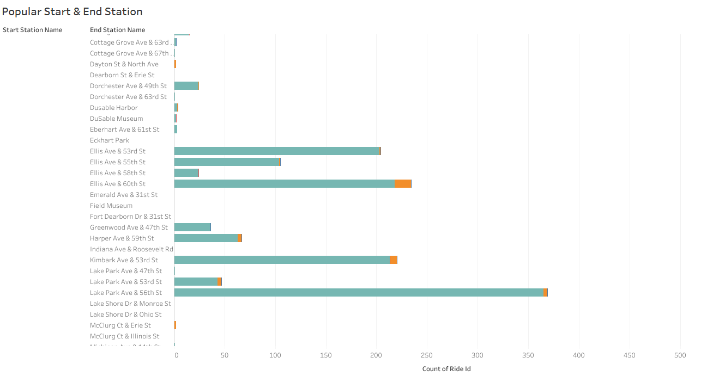
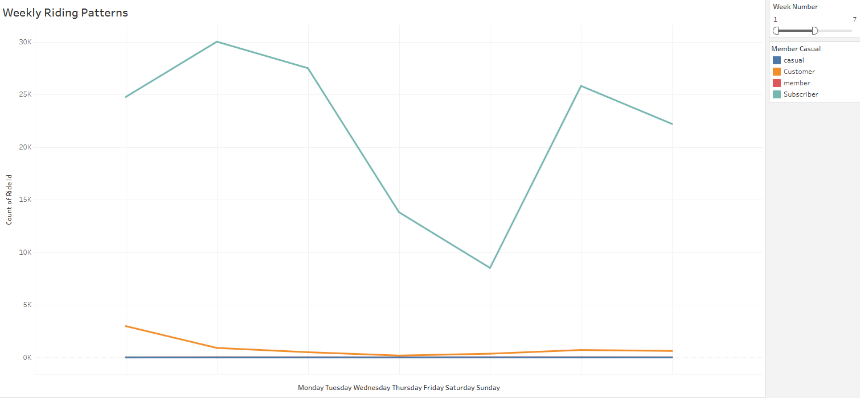
Share – Insights
Weekday riders often start at Union Station and end near residential areas, suggesting commuting. Weekend riders cluster around parks and waterfront stations, reflecting leisure use
Weekly trends show commuter reliance → service is tied to daily work-life routines
Notes:
🚲 Members dominate usage → retention is strong, but casual riders represent untapped growth potential.
📈 Weekly trends show commuter reliance → service is tied to daily work-life routines.
📊 Monthly growth trend → system adoption is increasing, but seasonality and demand forecasting must be considered.
🎯 Business opportunity → focus on converting casual riders and optimizing resources during high-demand months.

Slide 10
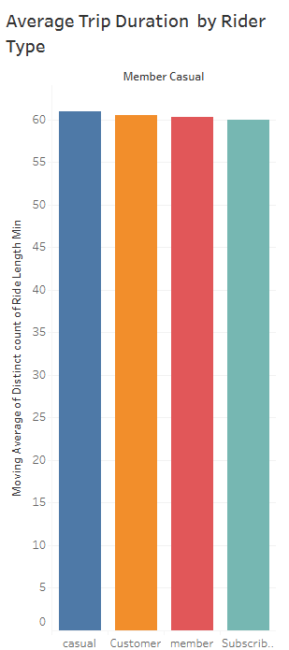
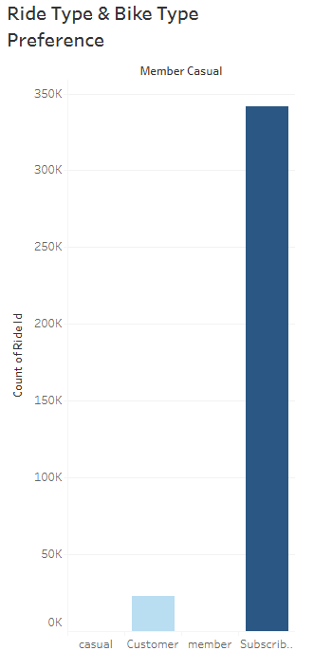
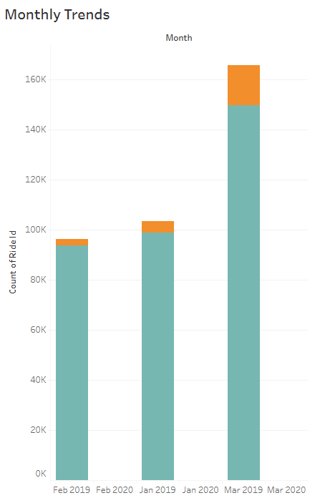
Share – Insights
Casual riders spend 2x more time per trip than members, highlighting the difference between recreational and commuting behaviors
Members favor classic bikes for efficiency, while casual riders use electric bikes more frequently for longer leisure rides
Members ride consistently across the year, but casual ridership nearly triples in summer — highlighting strong seasonality

Slide 11
Act- Recommendations
Problem statement: Turn insights into strategies that increase annual memberships and boost revenue.
Recommended Actions
Targeted Marketing Campaigns
Focus on weekend casual riders with offers to try weekday commutes as members
Highlight savings and convenience of membership vs single rides
Membership Incentives
Discounted seasonal membership trials (summer → fall transition)
Loyalty rewards for frequent casual riders
Product Enhancements
Promote electric bike availability in marketing to attract casual riders
Improve signage & station experience at high-casual-traffic locations
Expected Outcomes
Higher conversion rate of casual → member riders
Increased ride frequency and retention
Stronger long-term revenue growth
Deliverable
Action plan with specific marketing, product, and operational strategies informed by data
Notes:
Deliverable: Action plan with specific marketing , product, and operational strategies informed by data.

Slide 12

Closing Remarks
What I Would Do Differently
Include weather & event data to explain seasonal ridership shifts.
Compare weekday vs. weekend usage for deeper rider insights.
Add geospatial maps of top start/end stations for stronger visuals.
Automate data cleaning & analysis with SQL/Python for efficiency
Closing Remarks
Key Takeaway: Members ride year-round for short commutes; casual riders take longer, seasonal leisure trips.
Business Impact: Seasonal promotions could convert casual riders into annual members.
Next Steps: Recommend A/B testing marketing campaigns to validate strategies.

